Slide 1
HGB COLLEGE ENROLLMENT SYSTEM
STUDENT MANUAL

Slide 2
sERVICES
Sign-up
Enrollment
Sign-in
Student Page

Slide 3
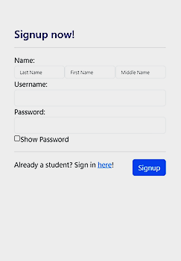
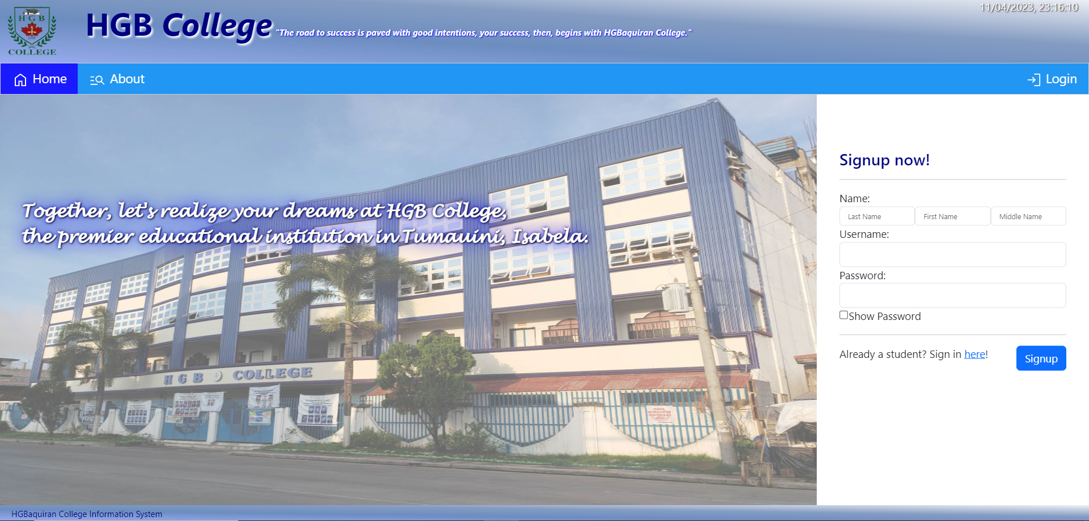
HOW TO Sign-up?
Services

Slide 4
Steps to signup
Services
Step 1. Fill out the following required data:
Last Name
First Name
Middle Name (If none, input N/A)
Username (must be unique)
Password
Step 2. Click Signup Button
After which, the system will prompt you to the Registration Form for the processing of Enrollment and updating of your profile.

Slide 5
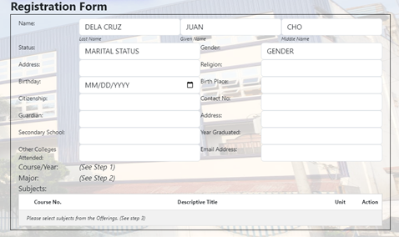
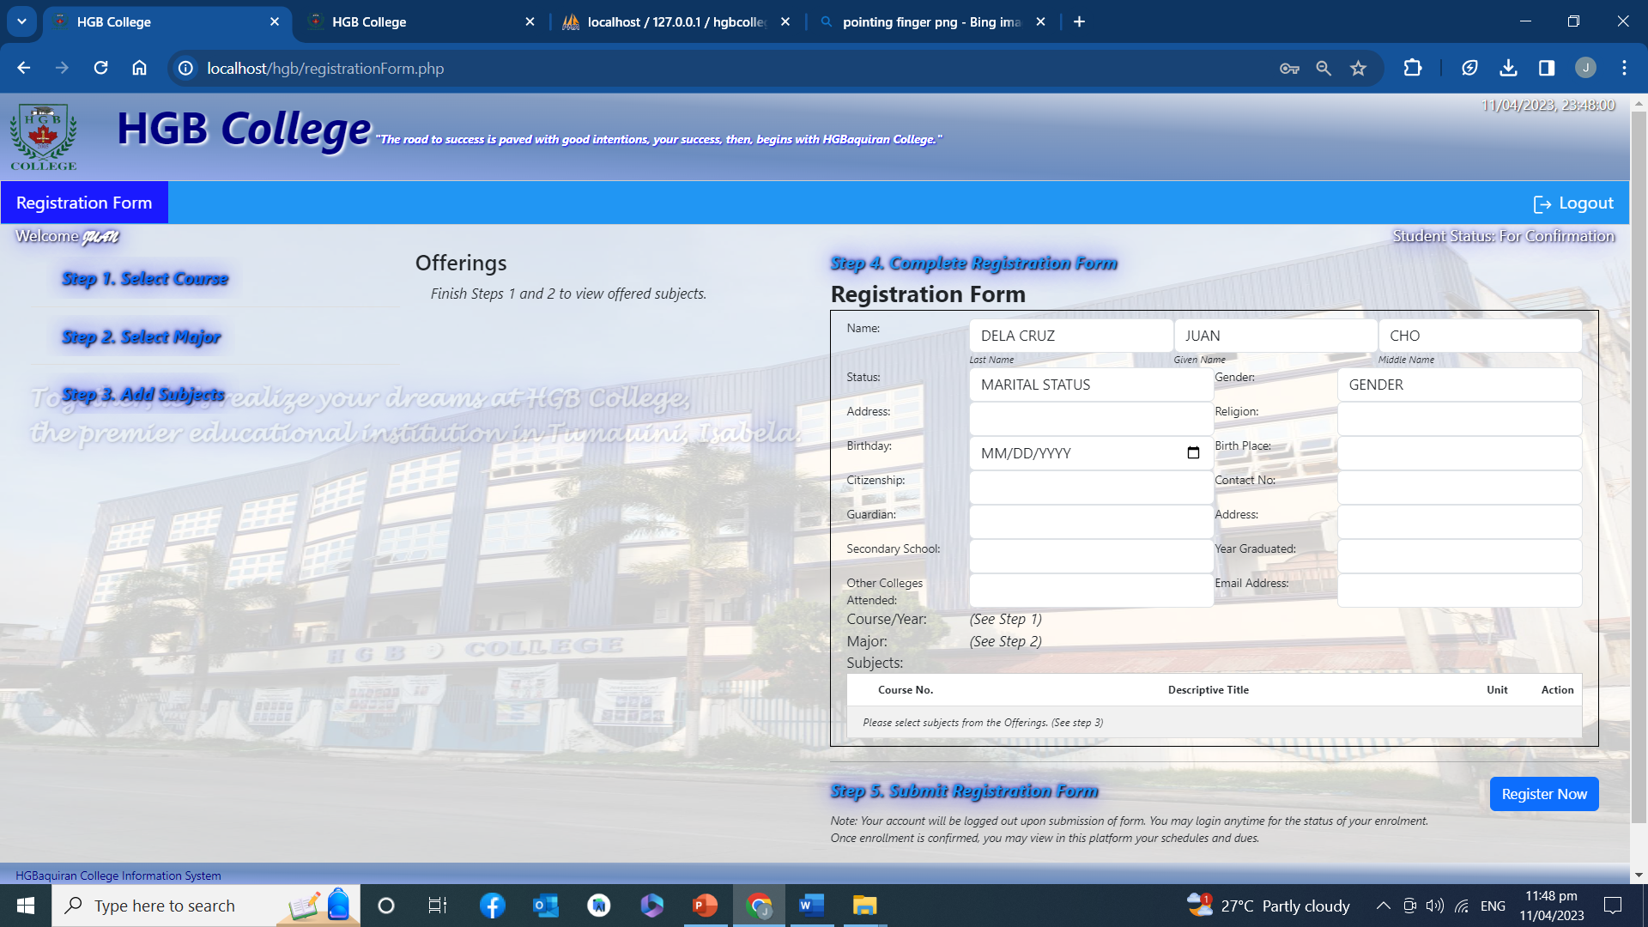
enrollment
Services

Slide 6
You must follow all the 5 steps
Services
Step 1. Select Course
Step 2. Select Major
Step 3. Add Subject
Step 4. Complete Registration Form
Step 5. Submit

Slide 7
Step 1. click select course
Services
This form will pop up as you select the “Step 1. Select Course” button.
In this form, you are to select your desired course, the year, and the semester you will enroll in.
After which, click the “Enroll” button and proceed to the next step.

Slide 8
Step 2. click select course
Services
This form will pop up as you select the “Step 2. Select Major” button.
In this form, you are to select your desired major.
After which, click the “See Offered Subjects” button and proceed to the next step.

Slide 9
Step 3. click add subjects
Services
This form will pop up as you select the “Step 3. Add Subjects” button.
In this form, you are to select subjects from the offered subjects within your desired year, course, major, and semester.
After which, click the “Add Subjects” button and proceed to the next step.

Slide 10
Step 4. COMPLETE REGISTRATION FORM
Services
As you go through the different steps, you may observe that this form is updating.
After finishing the first three steps, you, now, have to finish the form to complete your profile. These data are required.
In situations where you have nothing to answer, just input “N/A”.
After which, you may now proceed to the final step.

Slide 11
Step 5. Click REGISTer now
Services
The final step is clicking the “Register Now” button.
Your account will be logged out upon submission of the form. You may log in anytime for the status of your enrolment.
Once enrollment is confirmed, you may view in this platform your grades, schedules and transactions.

Slide 12
HOW TO Sign in?
Services
To sign in, you may click the “Login” button or click the “Sign in here!” link to prompt you to the Login Form.

Slide 13
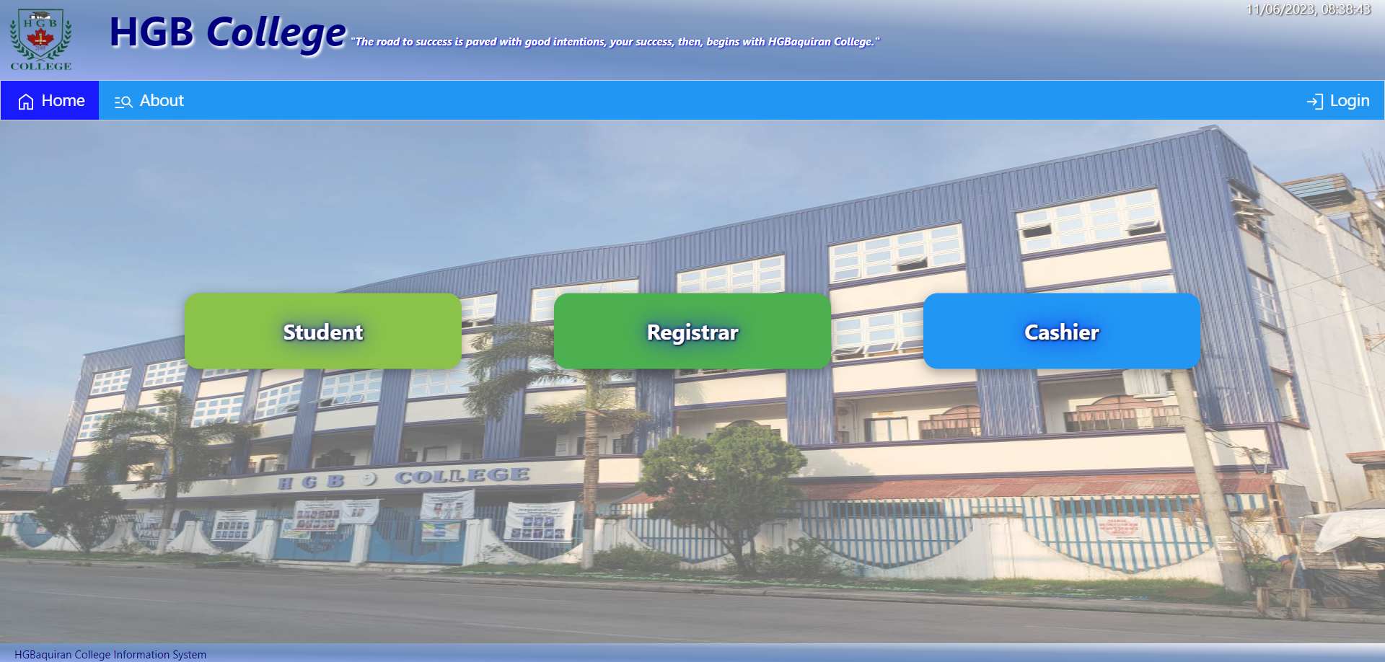
HOW TO Sign in?
Services
If you click the “Login” button, the system will prompt you to this page. Select the “Student” button to show the Login Form.
To sign in, the system will ask you for your username, and password.
For forgotten passwords and/or usernames, you may ask the registrar for assistance.

Slide 14
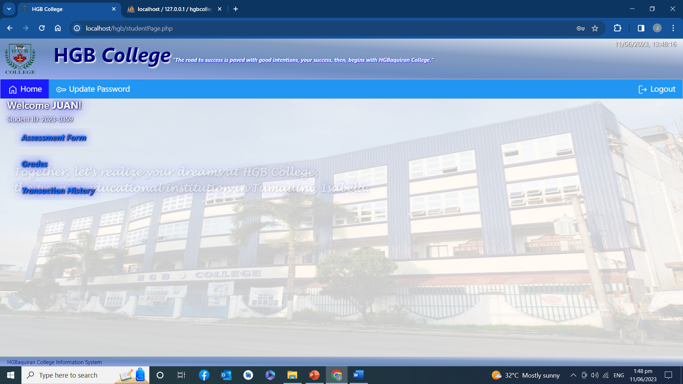
The student page
Services
Student Page allows students to view their Assessment Form, Grades, and Transaction History.

Slide 15
Assessment form
Services
By clicking the “Assessment Form” button, Students will be updated on their subjects, rooms and schedules, and their school fees.

Slide 16
grades
Services
By clicking the “Grades” button, Students will be updated on their grades.

Slide 17
Transaction history
Services
By clicking the “Transaction History” button, Students will be updated on their payment transactions.

Slide 18
Update password
Services
By clicking the “Update Password” button, Students will be allowed to change their passwords.
For forgotten passwords, ask the assistance of the registrar

Slide 19
HGB COLLEGE ENROLLMENT SYSTEM
STUDENT MANUAL

